Slide 1
IBM Captone Project
Leonidas Karnesis

Slide 2
Business problem
Which is the best place in London to make an investment and open a new restaurant?

Slide 3
Data used
https://en.wikipedia.org/wiki/List_of_English_districts_by_population_density

Slide 4
Methodolgy
Used the data of the most crowded areas of London.
Find the coordinates of theses areas and find the nearby venues through Foursquare.
Find the most common venues in each District and divide into 4 clusters
Based on which place doesn t have many other restaurant to limit competion decide which is the best place for investment.

Slide 5
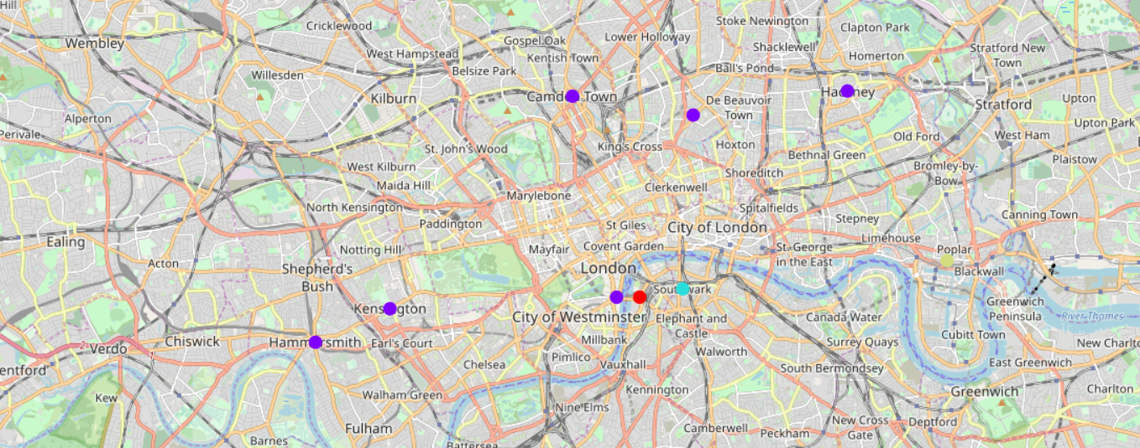
Results

Slide 6
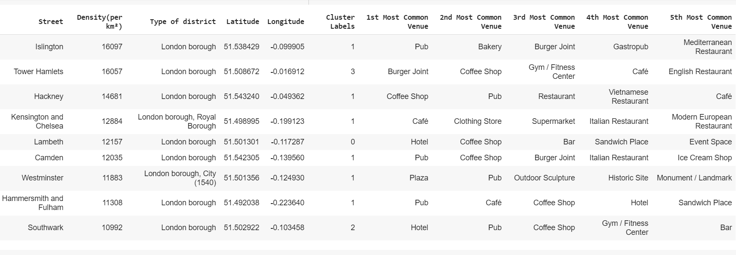
Results

Slide 7
Conclusion
The most appealing option to open a restaurant is cluster 1 in which only Lambeth exists.
Lambeth doesn't t have many restaurants comparably with the other clusters while it seems it is a lively area with bars and coffee shops.
Lambeth doesn't t have many pubs as well as an alternative to eat.
Lambeth has also many hotels which means it is attractive to tourists as well.

